Slide 1
Working out the ointment technology on the bases of extract from medicinal raw material
D.X.Rajabova- master of Tashkent pharmaceutical institute
Supervisor: professor of Medicinal forms technology department D.Ph.S. Z.A. Nazarova

Slide 2
The actuality of research:
At present, the application ointments of medicinal forms based on natural raw materials is considered an important function for the production of pharmaceutical technology. Especially the most vital problems are to find cheap and especially effective raw materials, and produce ointments based on different compositions of medicinal forms. Ointment is one of the ancient forms of drug. In the prescription, it consists of 15%. Ointments are semisolid preparations for external application of such consistency that they may be readily applied to the body or to the mucous membranes. They should be of such composition that they soften but not necessary melt when applied to the body.

Slide 3
The aim of the research:
To work out technology and to select the ointment composition for the skin inflammation by aerial extract of medicinal plants as sage, equisetum and milfolli.
Research methods and materials: in order to achieve the aim, natural raw materials were used as an object: medicinal Sage (Savia officinalis) Sage leaf is a traditional, herbal medicinal product for relief of minor skin inflammations and bacterial infections of the skin.
Horsetail (Equisetum arvense) It is a widely used anti-inflammatory agent. Anti-inflammatory effect as evaluated in mice by applying hydroalcoholic extract of horsetail to mice. Due to its anti-inflammatory property, it is used to treat arthritis, chilblains, cystitis, gout, inflammation of the lower urinary tract, renal gravel. It is considered as a specific remedy in cases of inflammation or benign enlargement of the prostate gland. The tea makes a good wash for wounds, sores, skin problems and a gargle for mouth and gum inflammations.
Milfoil (Achillea millefolium) Millefolii herba contains essential oil (the major components of which are sesquiterpenes of the guaianolide type (chamazulene), α-, β-pinene, tannins (condensed and hydrolysable), sesquiterpene lactones (matricine), and flavonoids (luteolin, apigenin, isorhamnetin, rutin) on extracts from aerial, petrolatum, and lanolin were obtained as a basis of ointment.
Vegetable raw materials extract was obtained by 70% ethyl alcohol by maceration (1:1:1). Ointment was prepared on the basis of 10% petrolatum and lanolin (9:1).

Slide 4
Quality indicators of extracts:
appearance,
color,
odor,
application,
structure,
pH,
colloids and stability.

Slide 5
Result:
Ointment meets the requirements of quality on the basis of hydrophobic.

Slide 6
Conclusions:
It was worked out the ointment technology of local medicinal plant raw materials of medicinal Sage, Horsetail and Milfoil on hydrophobic base and estimated the quality. There have been estimated the quality of ointment and according to this the ointment, which worked out, is stable for the normal temperature (28C), it is softly applied to the skin inflammatory diseases. Inflammation is a complex process, essential for the host defense system. Excessive production of some inflammatory mediators may lead to chronic diseases. Plant raw materials can have an anti-inflammatory action affecting various stages of the process of inflammation. They inhibit formation of cytokines and eicosanoids, prevent the inflammatory reaction cascade from starting, and diminish skin flare, itching or excessive exfoliation. The use of most of the presented herbal medicines in treatment of inflammatory skin diseases is based on clinical and pharmacological trials in vitro and experiments in vivo. But the use of some of them is based solely on their longstanding traditional use in folk medicine.

Slide 7
List of literatures:
The State Pharmacopeia of the USSR XI ed. M., “Medicine”. 1984 part I and part II.
Минина С.А., Каухова И.Е. Химия и технология фитопрепаратов. М. 2009. с-192-197
Тихонов А.И., Ярных Т.Г. Технология лекарств. – Харьков.-2002 с-704

Slide 8
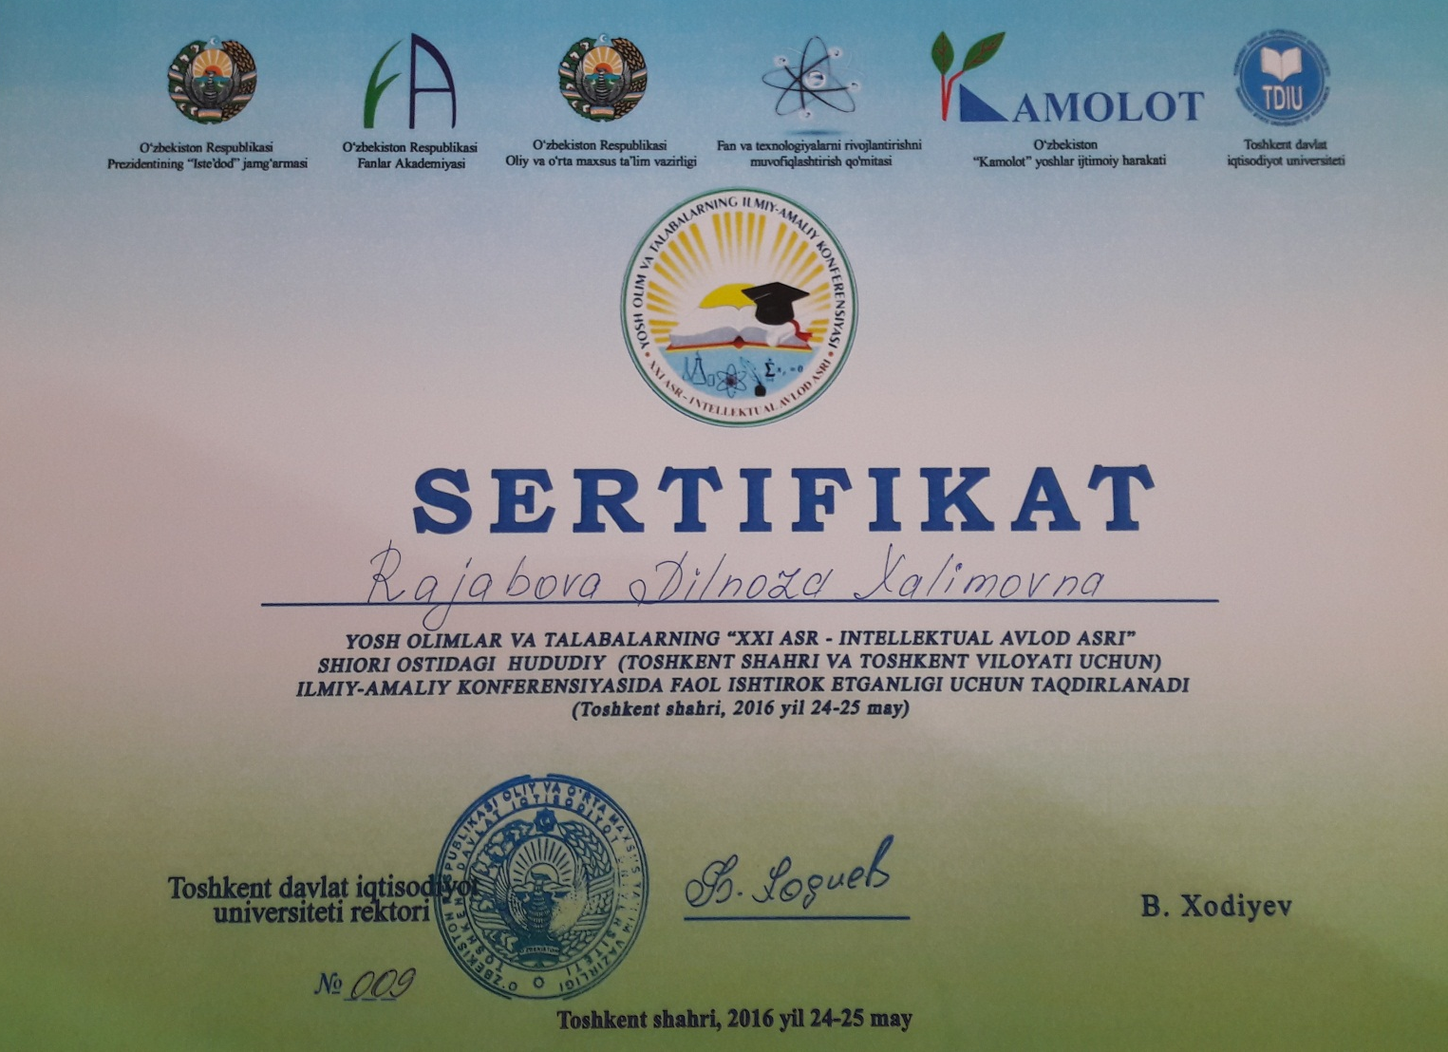

Slide 9
